Slide 1
CSC 3210 Computer Organization and Programming
Lab Work 13
Dr. Zulkar Nine
mnine@gsu.edu
Georgia State University
Spring 2021

Slide 2
Learning Objective
Procedures

Slide 3
Disclaimer
The process shown in these slides might not work in every single computer due to Operating system version, Microsoft Visual Studio versions and everything.
If you find any unusual error, you can inform the instructor.
Instructor will help you resolve the issue.

Slide 4
Attendance!

Slide 5
Lab Work 13 Instructions
Lab 13 : Write a search function
Due Date: 04/23/21 11:59 PM

Slide 6
Passing Register Arguments to Procedures:
Example 1: Write a procedure that adds the passed parameters (eax,edx, and ecx) and returns the result in eax.
The main procedure is shown below. Then execute the program and trace its execution and report exa value.
Remember to use step into (Fn+F11) when tracing a procurer's call

Slide 7
Passing Register Arguments to Procedures and Calling External procedures:
Example 2: Write the following program
.386
.model flat,stdcall
.stack 4096
ExitProcess proto,dwExitCode:dword
.code
main PROC
mov ebx,1431 ; pass two parameters, in order
mov ecx,63
call AddTwo ; look for return value in EAX
invoke ExitProcess,0
main ENDP
AddTwo PROC
Mov eax,0
add eax,ebx
add eax,ecx
ret
AddThree ENDP
end main
Remember to use step into when tracing a procedure’s call

Slide 8
Lab 13
Submission

Slide 9
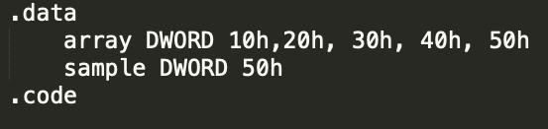
Submission (1)
Write a function that search an item in the array
The .data section contains two items – “array” and ”sample”
You have to write a procedure that search “sample” in the “array”.
If the item is found return the item using EAX register, otherwise, return -1 using EAX register.
You can pass the parameters using registers
Push the register arguments at the beginning of the procedure. And pop them at the end of the procedure.
Detail documentation of the procedure is in the next slide

Slide 10
Submission (2)
;---------------------------------------------------------
; This Procedure search a given item in a given array
; Receives: EBX, ESI, ECX, EDX content as input.
; EBX contains the item we want to search on the array
; ESI contains the address of the first item in the array
; ECX contains the number of items in the array
; EDX contains the size of each item in the array
; Returns : EAX,
; If the item found in the array, EAX stores the item we are searching
; Otherwise, EAX contains -1
; Requires: Nothing
;---------------------------------------------------------
Search PROC
; implement the procedure
ret
Search ENDP

Slide 11
Submission(3)
Skeleton code for the procedure
Search PROC
; save a copy of the registers in the stack
; Implement Search here
; re-store the items from the stack
ret
Search ENDP

Slide 12
Submission (3)
Submit the screenshot of your code.
Debug your code until you reach INVOKE ExitProcess, 0
Take a screenshot of the watch window showing EAX content
Submit the screenshot.
Also, Rename the asm file using your last name as Lastname.asm
Submit the ASM file as well.

Slide 13
Appendix A
Checking Memory Data

Slide 14
Checking Memory Data
Use Memory window to verify the values of memory locations.
To activate Memory window, run the debugger, go to debug menu and click on windows, open it, go to Memory then choose Memory1.
When you run your program and step over every line you will see the changed values marked with red color.
You Must be in the Debugging Mode to see the memory or the register window

Slide 15
Checking Memory Data
To activate Memory window,
if you want to see the location of your variable in the memory,
Memory window search box (on the top of the memory window, Address:)
write & follow it with the variable name: example: &myVall.
This will take you to the memory locations of your program (.data section).

Slide 16
Checking Memory Data
To activate Memory window,
You can right-click inside the memory window
You will see Popup menu for the debugger’s memory window
You can choose how you want to group your bytes: by 1,2,4, or by 8
You can also presents data in hexadecimal, signed, or unsigned display

Slide 17
Appendix B
Create a Project

Slide 18
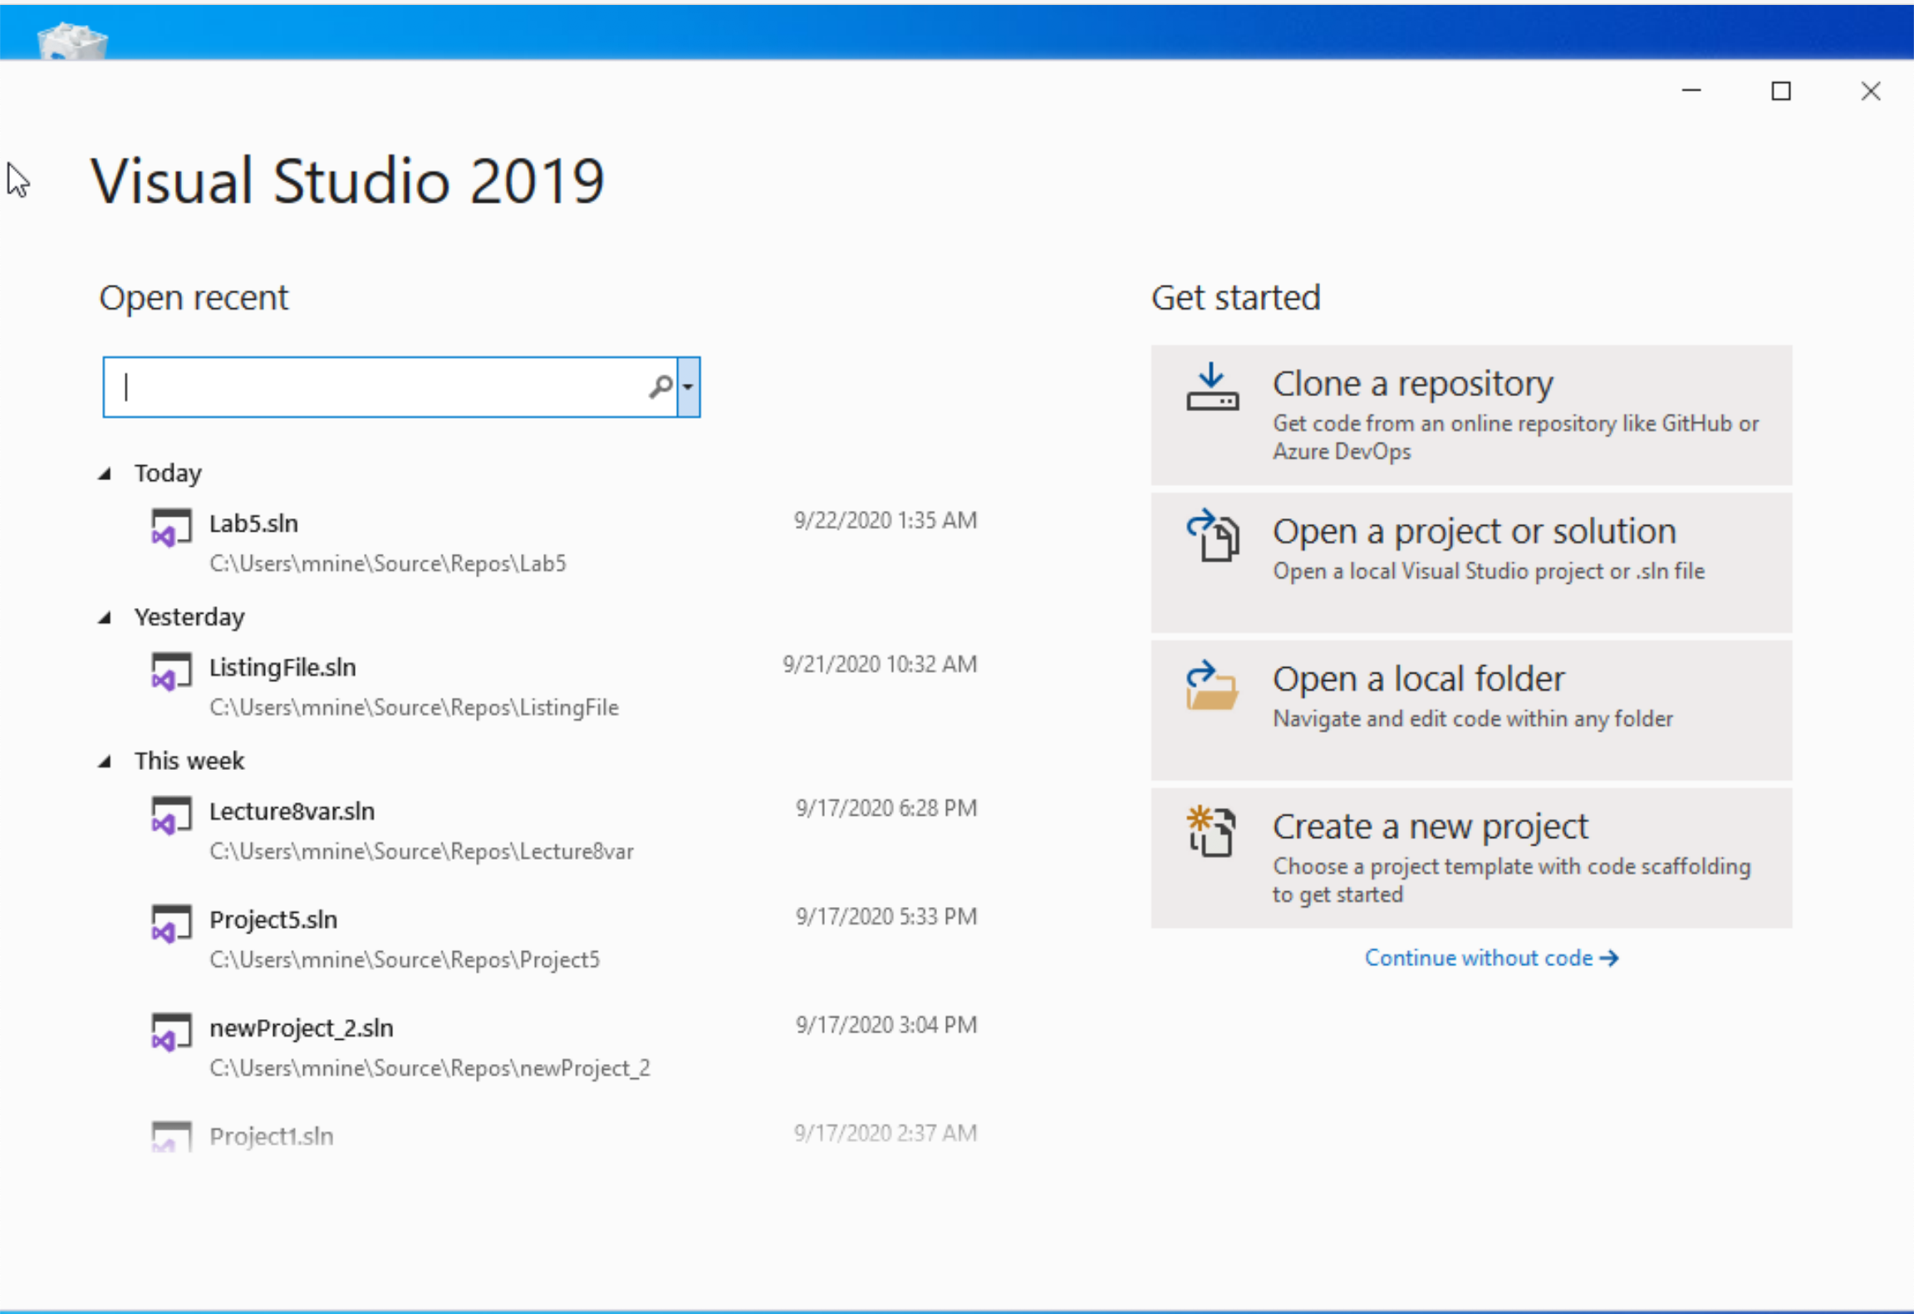


Step 1: Create a project (1)
Start Visual Studio
Click Create a new Project

Slide 19
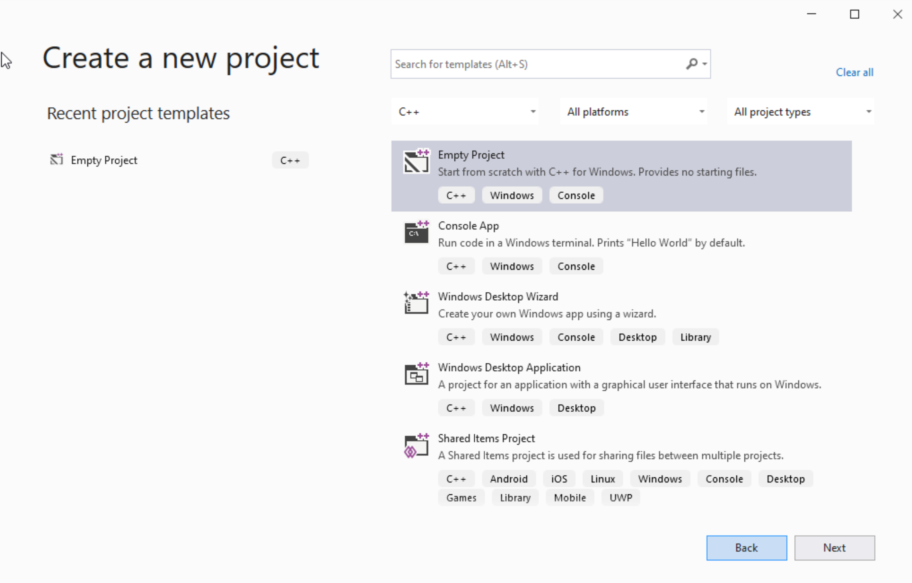




Step 1: Create a project (2)
Select C++ as language
Select Empty Project
Click Next

Slide 20
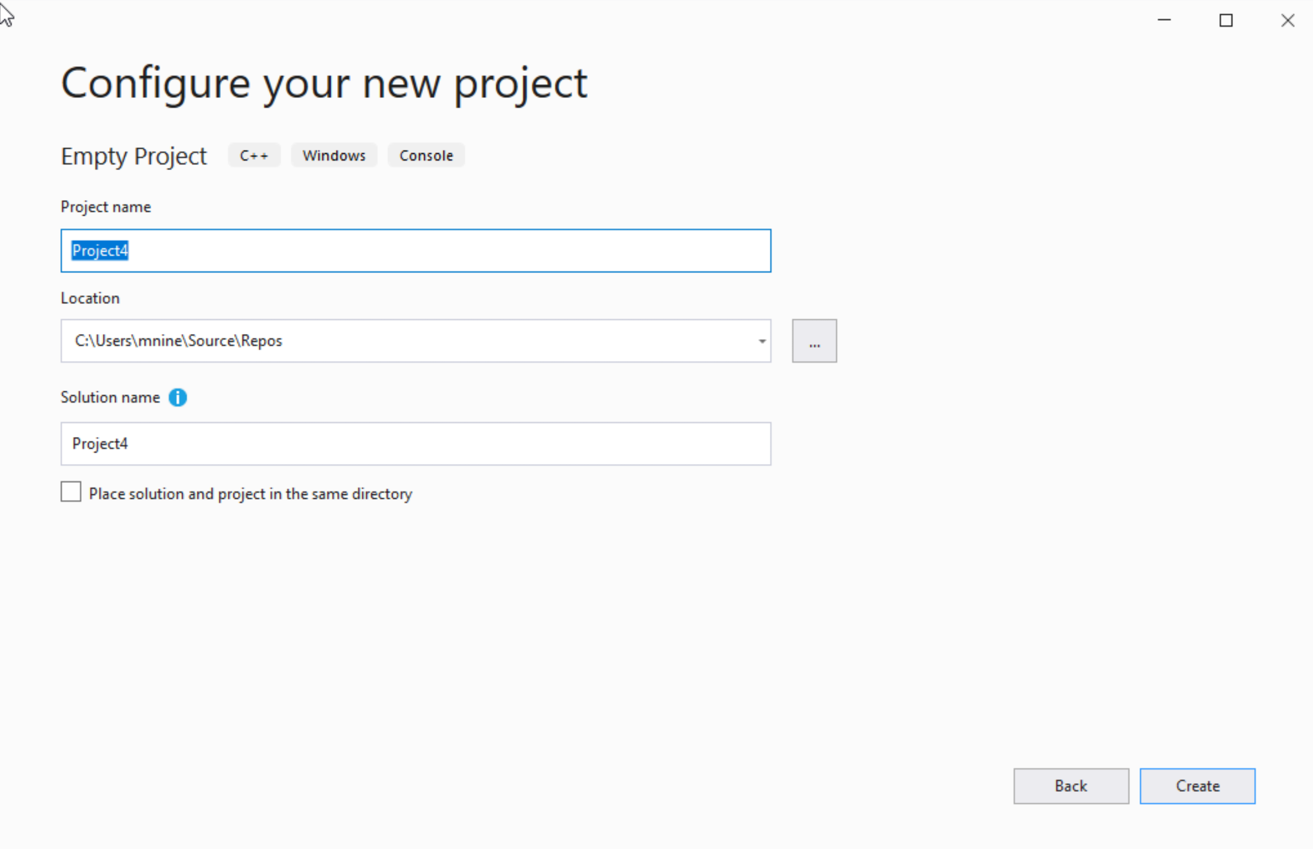

Step 1: Create a project (3)
You can change the project
name as you like
Also, you can change the
project location
Click Next

Slide 21
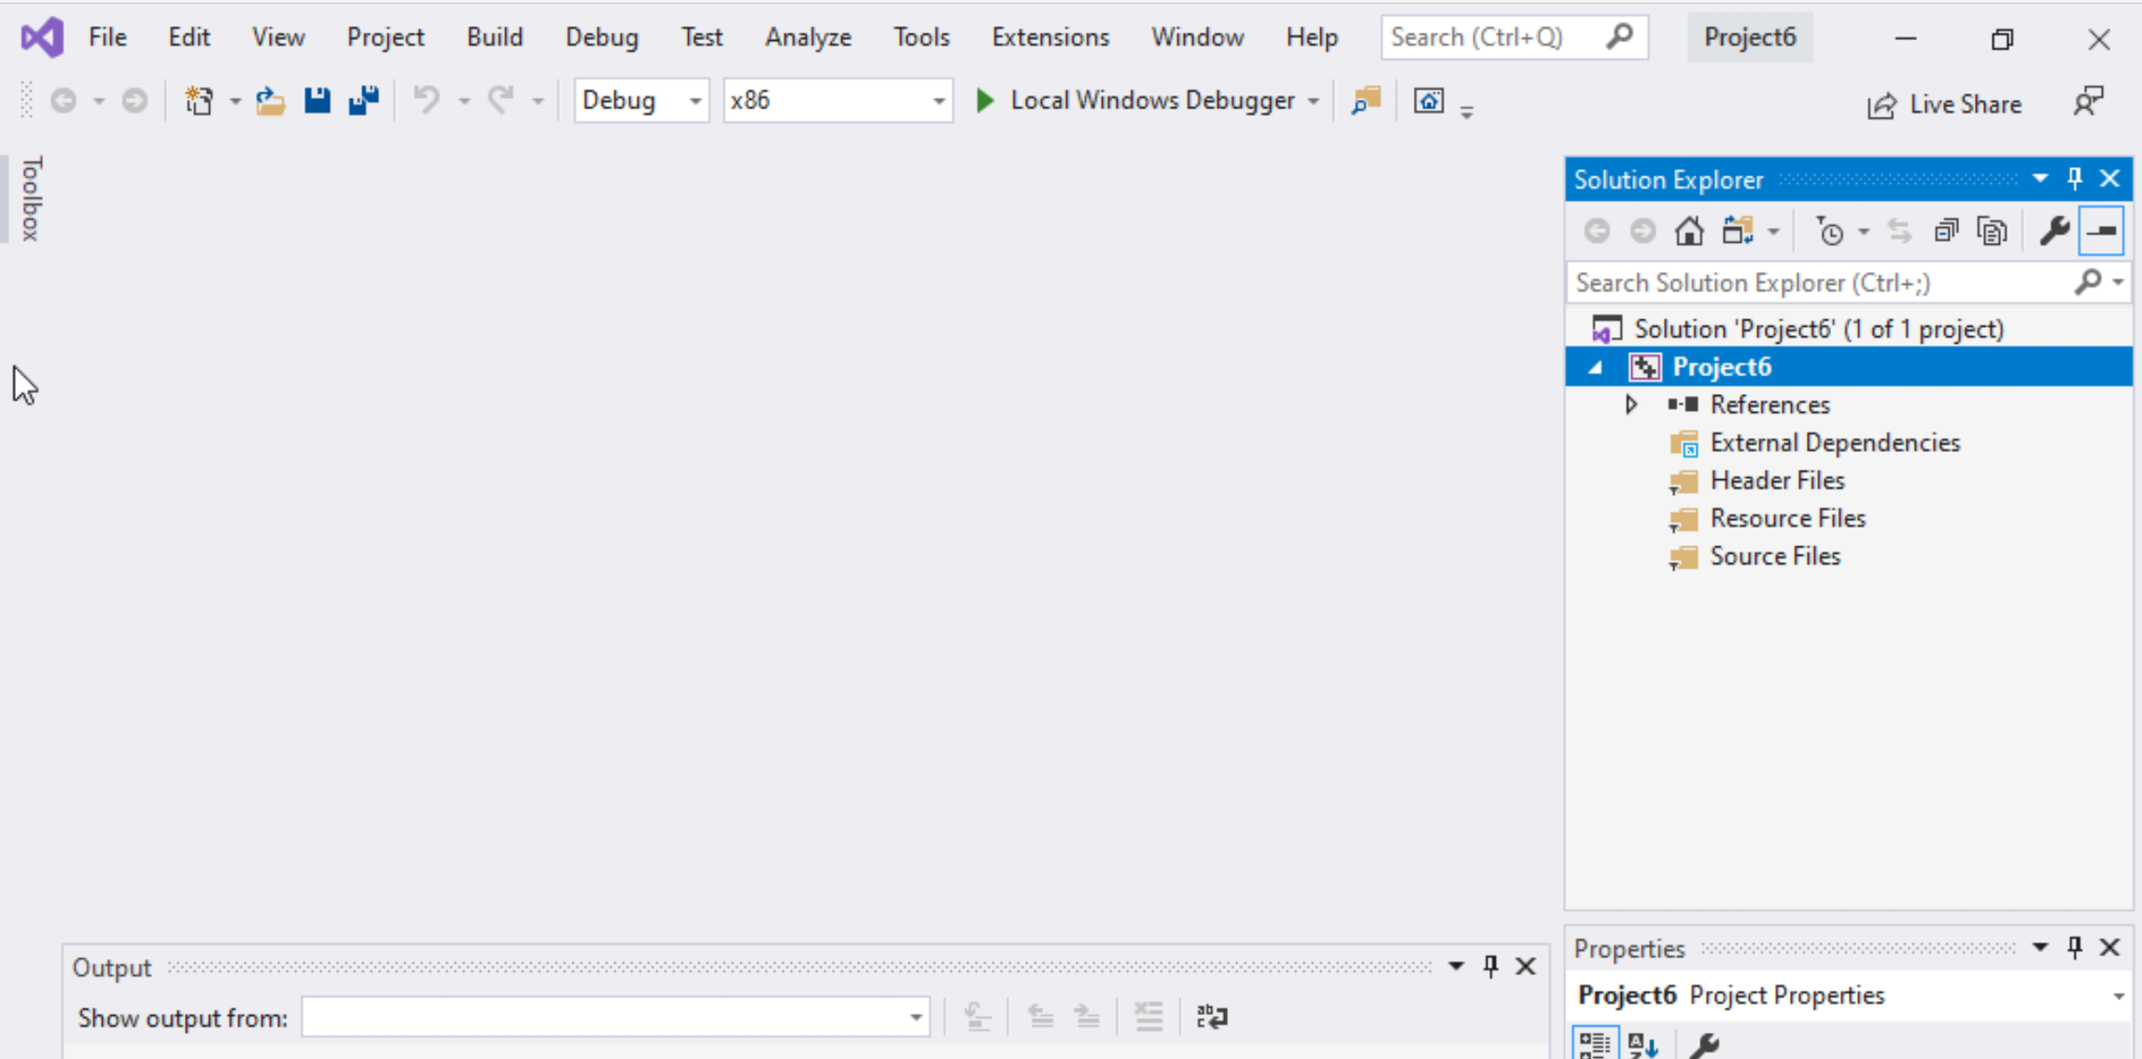
Step 1: Create a project (4)
Delete the
Following folders:
Header files
Resources Files, and
Source Files

Slide 22
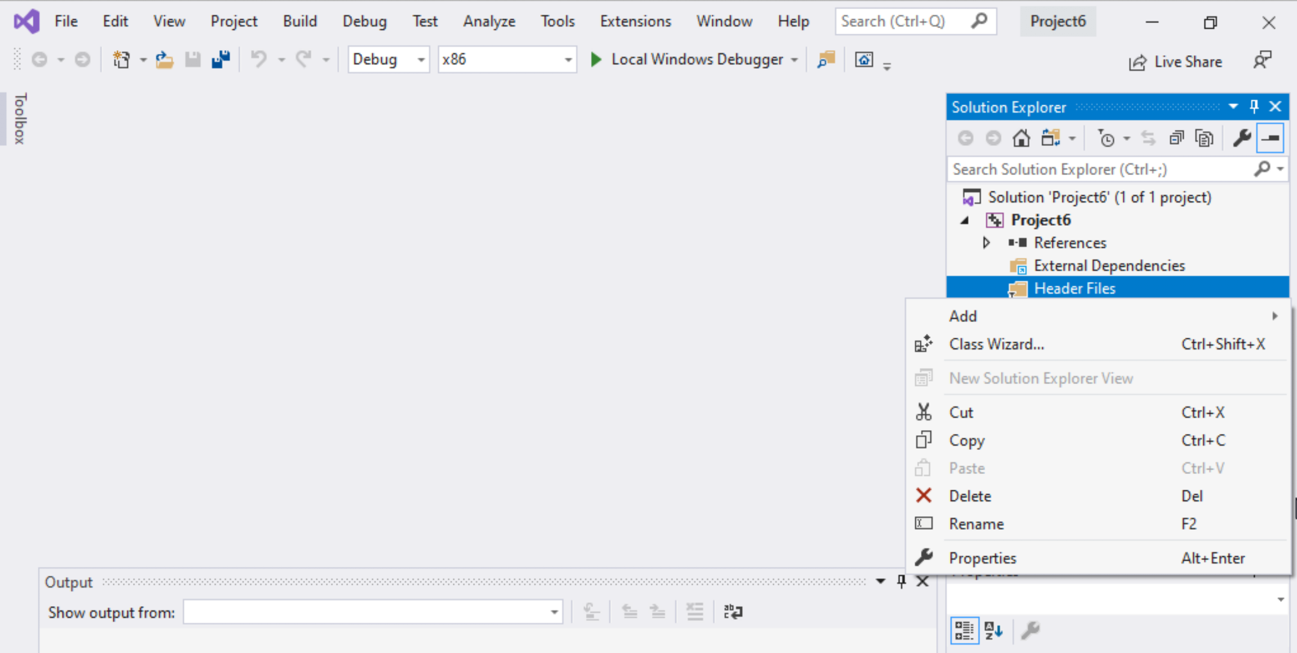
Step 1: Create a project (5)
To delete :
Select the folders
Right click on it
Select delete

Slide 23
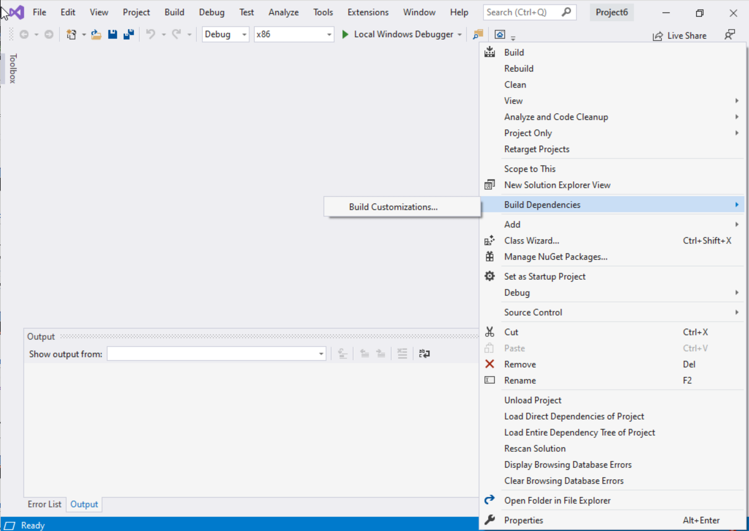
Step 1: Create a project (6)
Select Project Name on solution explorer
Right click on it
Go to Build Dependencies
Click on Build Customizations

Slide 24
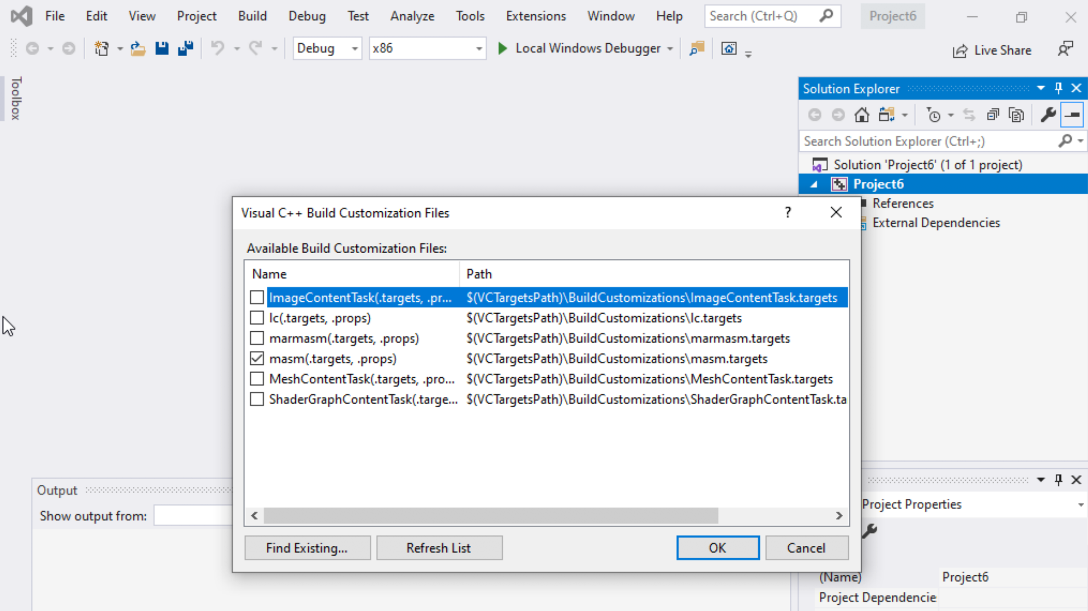
Step 1: Create a project (7)
Select masm(.target, .props)
Click ok

Slide 25
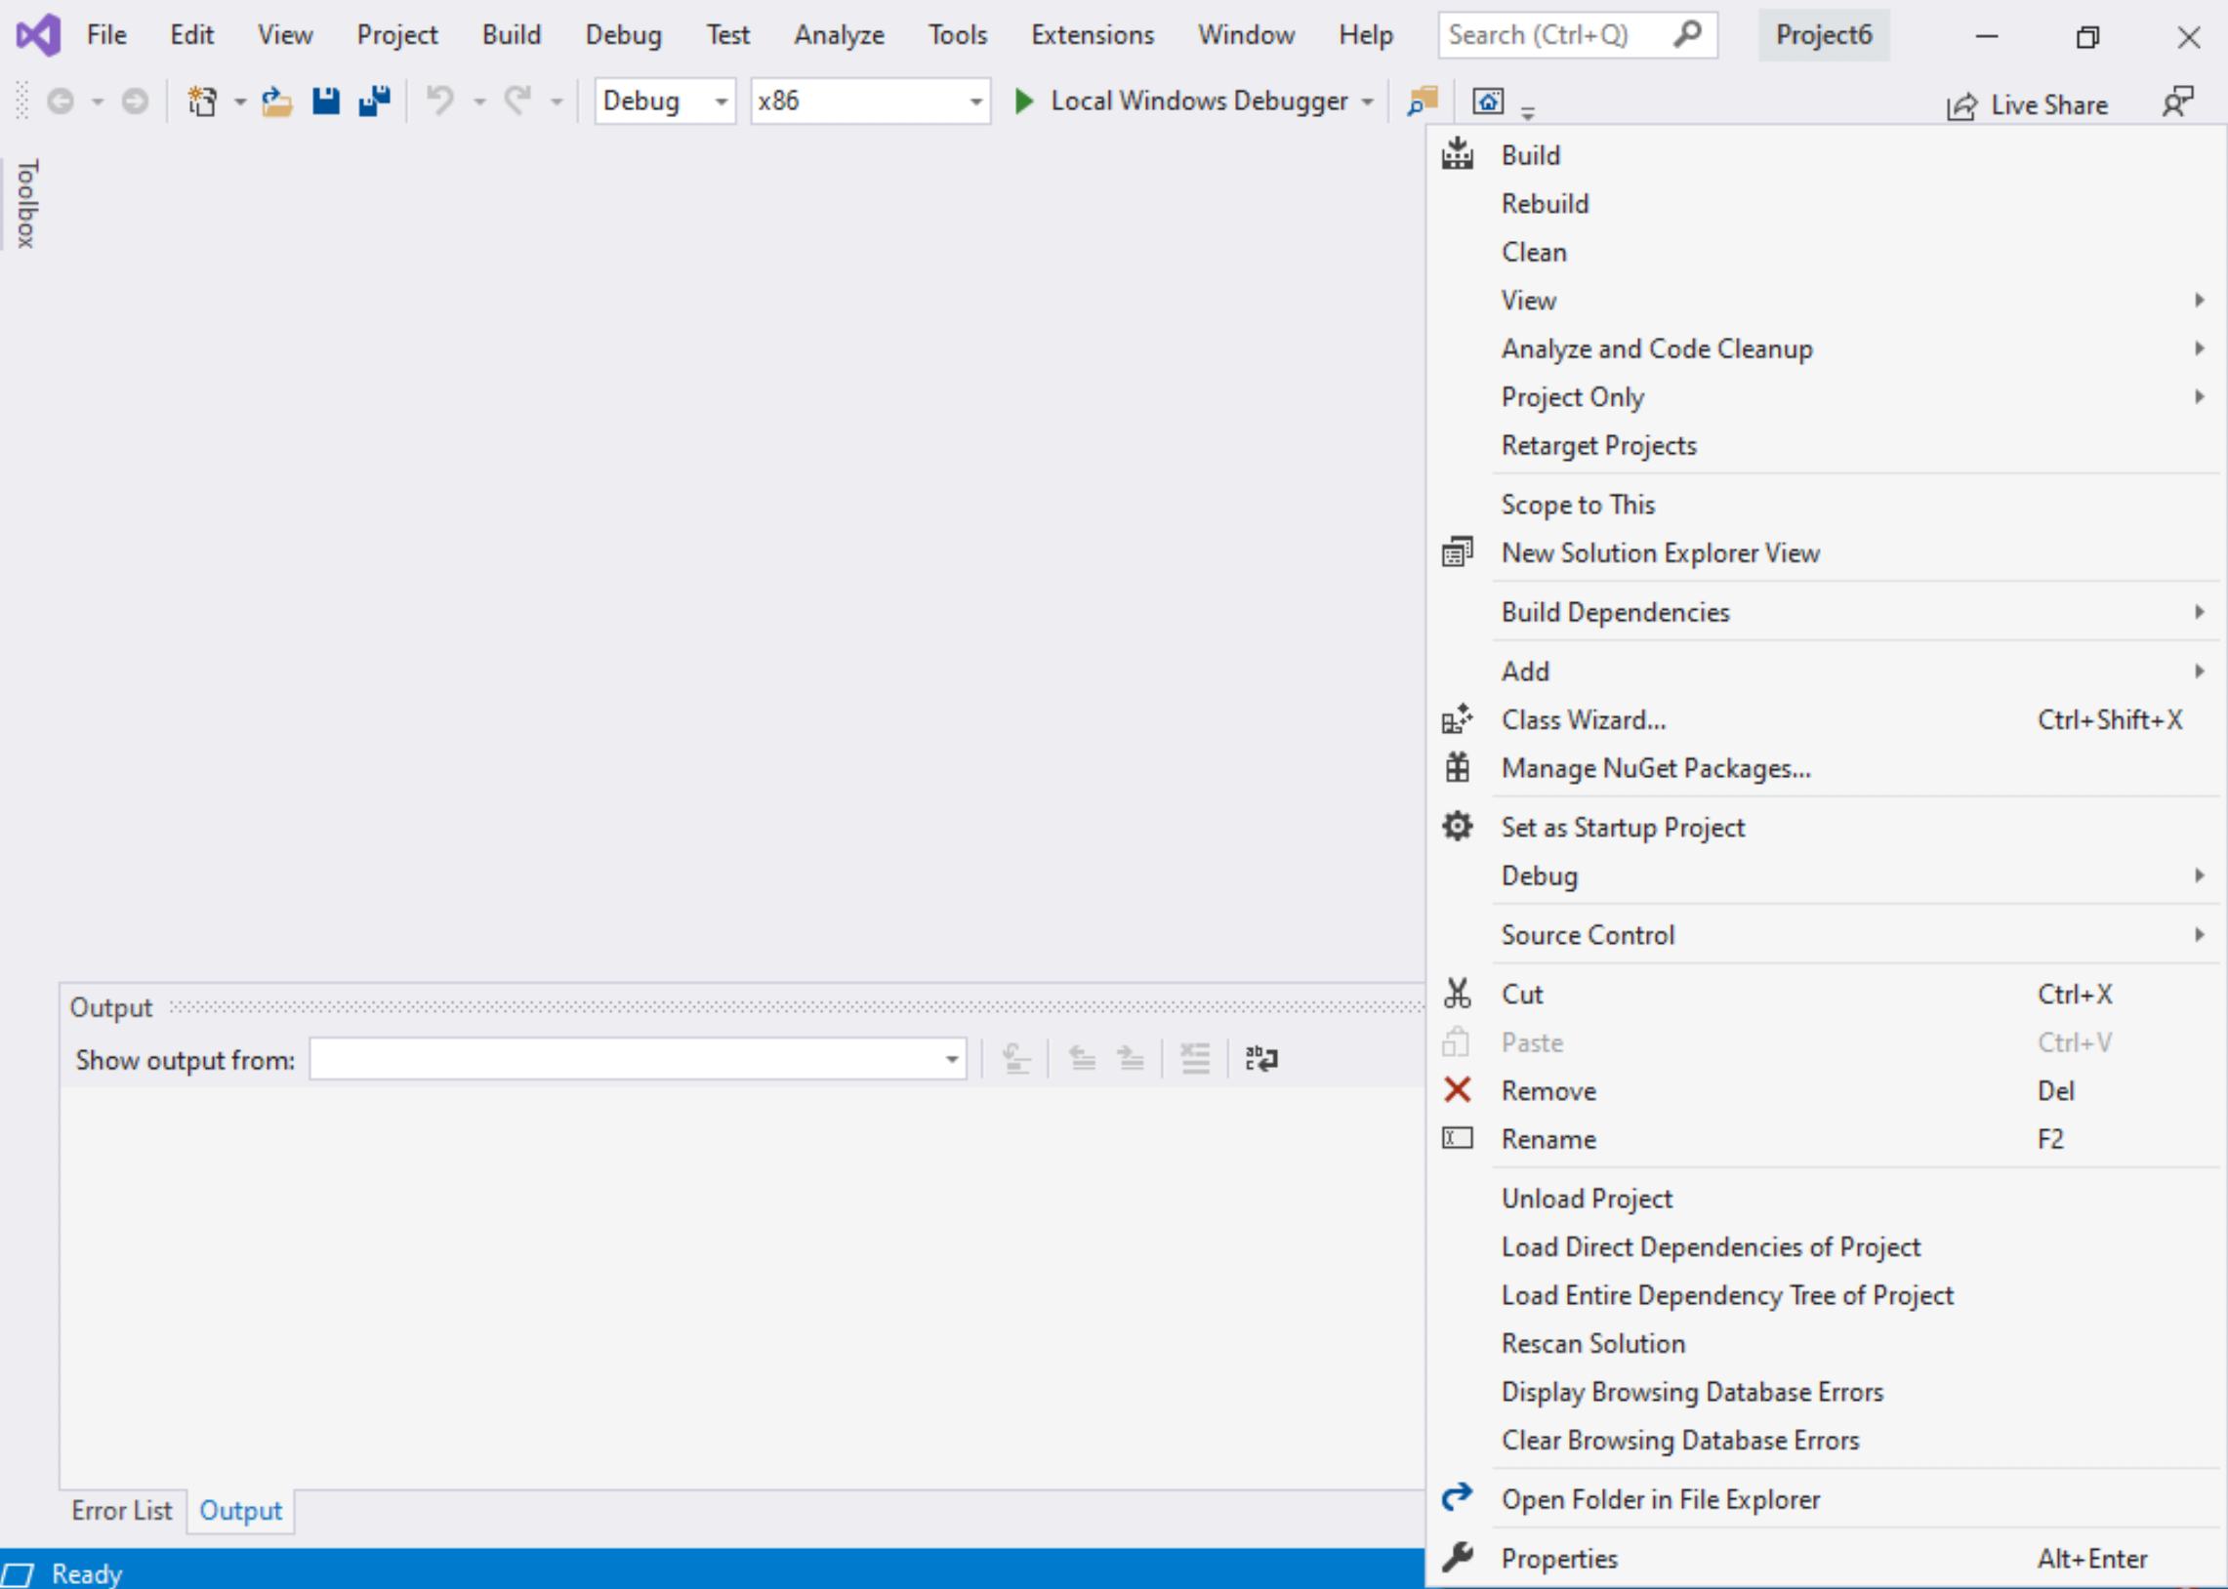
Step 1: Create a project (8)
Right click on the Project name in the solution explorer
Click properties

Slide 26
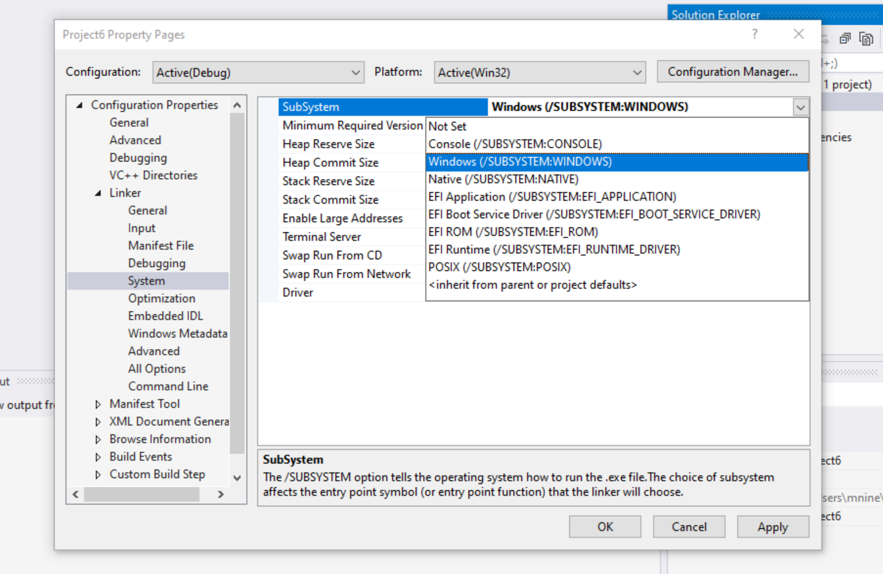

Step 1: Create a project (9)
Expand the ‘Linker’
Select ’System’
Select Windows(/SUBSYSTEM:WINDOWS)
Click OK

Slide 27
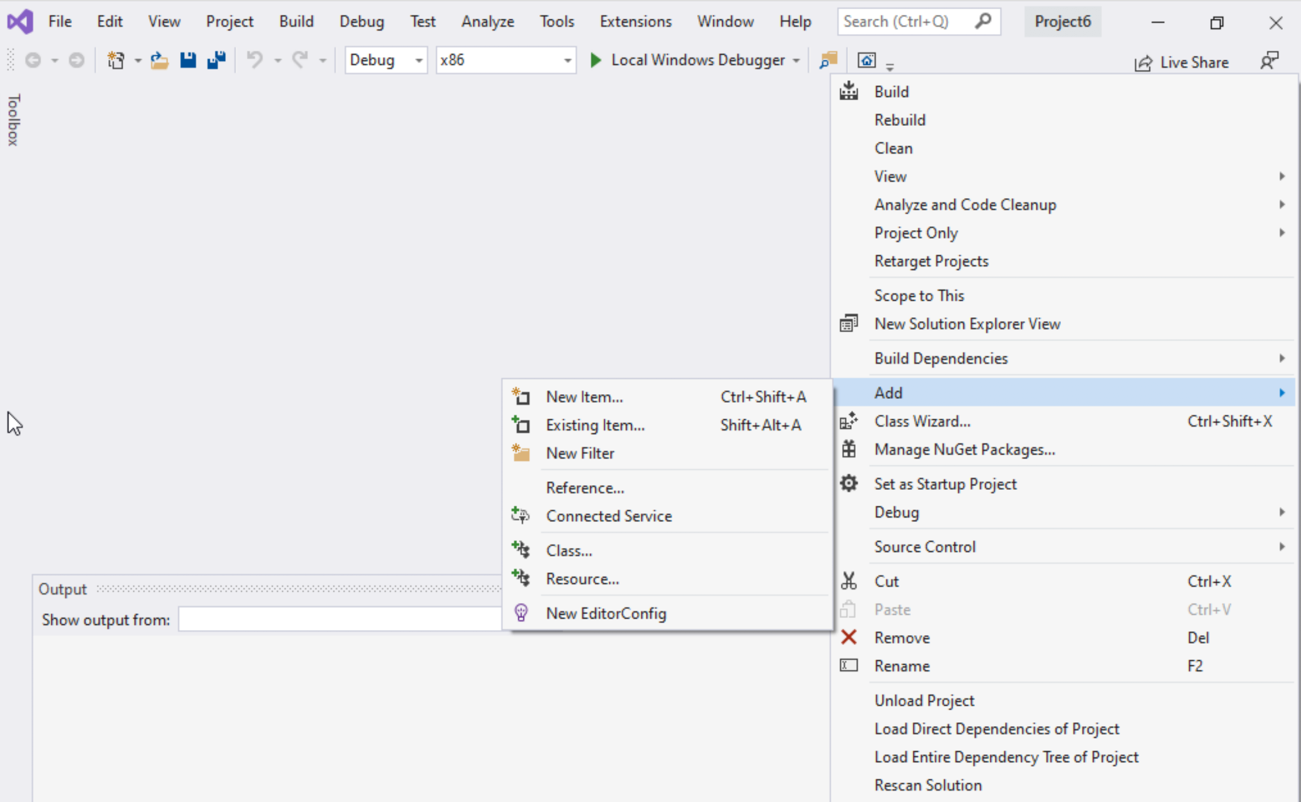
Step 1: Create a project (10)
Select Project name on solution explorer
Right click on it
Expand Add
Choose New Item

Slide 28
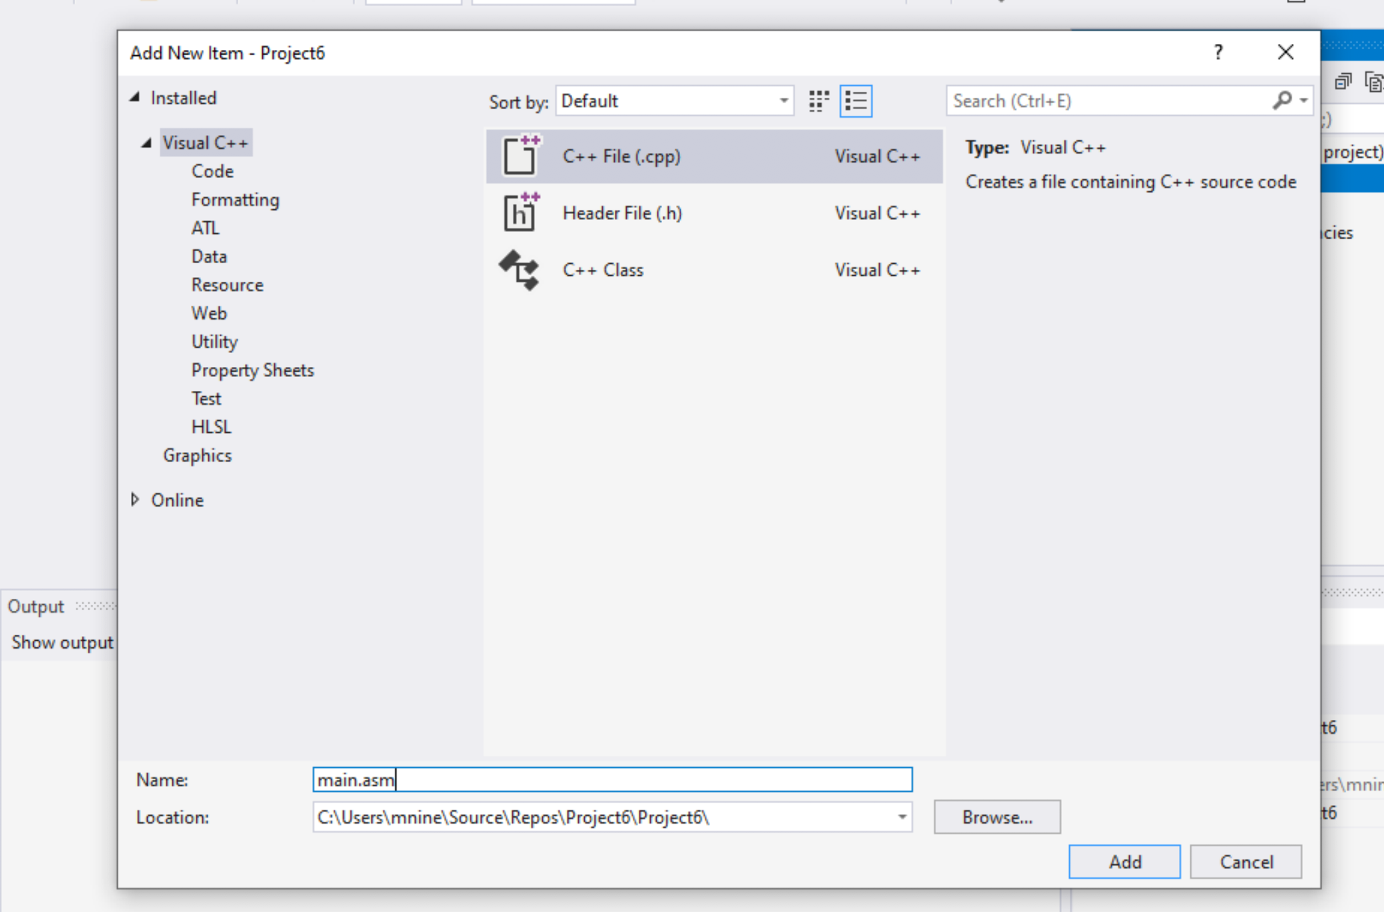


Step 1: Create a project (11)
Select C++ File(.cpp)
Name: main.asm
Click Add

Slide 29
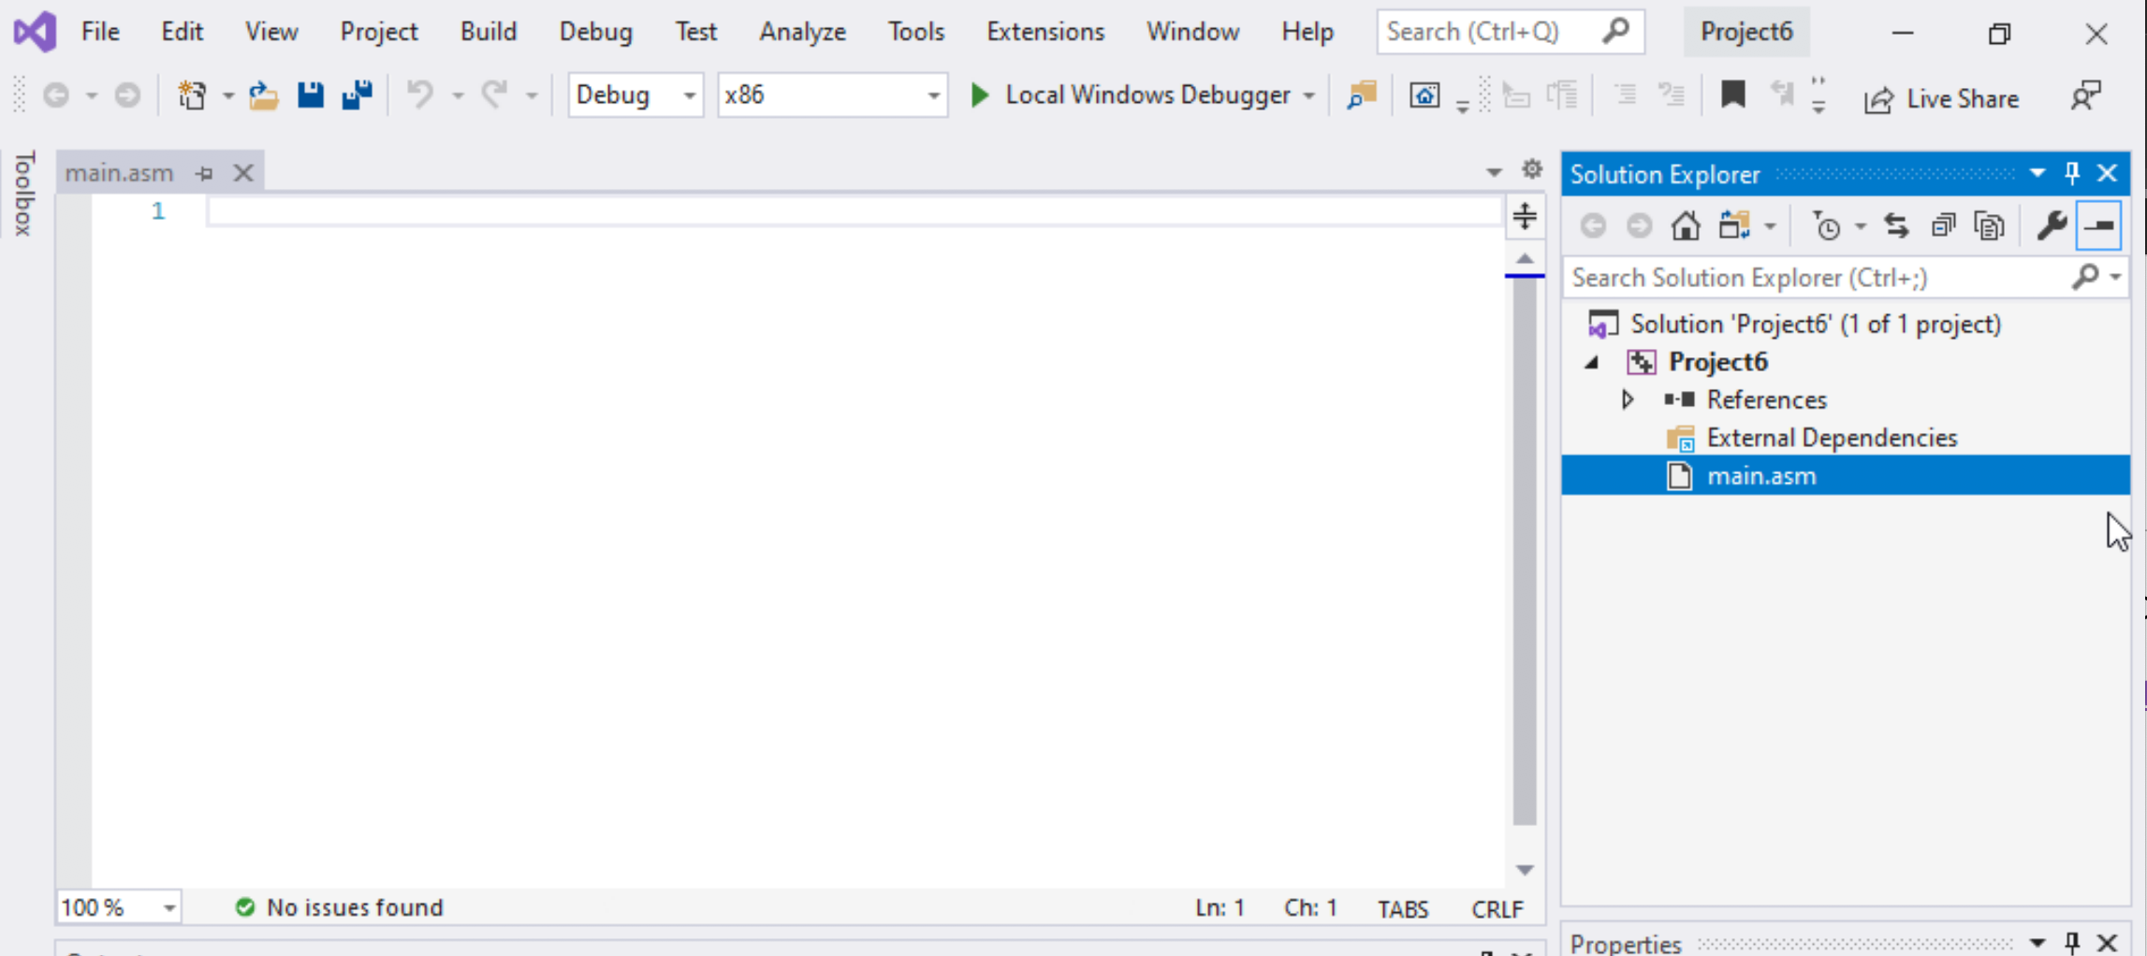

Step 1: Create a project (12)
Select main.asm
Add your code
In the main.asm File.

